Slide 1
A short Linux History of UNIX/Linux

Slide 2
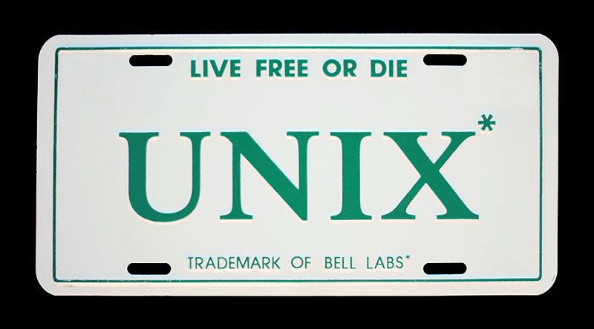
First there was UNIX

Slide 3
UNIX WAS INVENTED BY
Ken Thompson and Dennis Ritchie at Bell Labs
In 1969 there was no Verizon, NYNEX,US West ,etc. just “The Phone Company”. Thompson and Ritchie worked at Bell Labs (R&D facility)
They First Developed on a PDP-7 found in the basement
Wrote in assembler , like other operating systems of the day

Slide 4
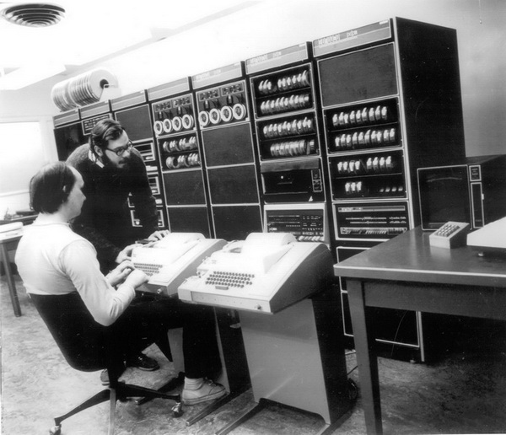
Later
They rewrote UNIX in C and ported it to other systems.
C was invented for UNIX to be machine independent

Slide 5
AT&T (BELL) A.K.A. The phone company
Charged $20,000 for commercial companies to license UNIX.
$150 for non-profit. I.E. Universities
No Support
Unix was modified by universities such as Berkley and gave birth to BSD (Berkley Standard Distributions)

Slide 6
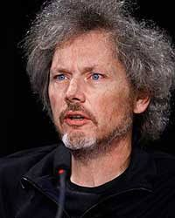
A noted BSD contributor was
Bill Joy
He invented the vi editor and later became VP of Sun
BSD Versions of UNIX commands

Slide 7
Setting the Stage for Linux
There needed to be a low-cost or “free” C compiler to compile a *nix kernel.

Slide 8
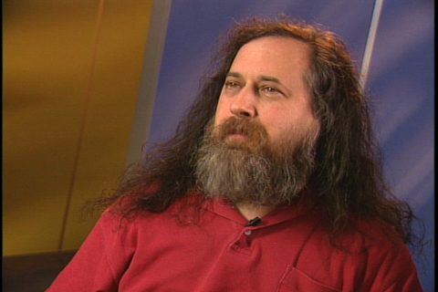
The Rise of Open Source
Richard Stallman wrote a “free” C compiler.
Started the Free Software Foundation
“Free as in freedom not free beer”
GNU (GNU’s Not UNIX) projects

Slide 9
The Problem with UNIX
Is that it was licensed from AT&T (later Others).
UNIX Name very restricted
Started to Charge for C compilers
  Which gave rise to distribution names like
    AIX -IBM
    Solaris – Sun/Oracle
    HP-UX - HP
    Xenix – Microsoft (yes Microsoft)

Slide 10
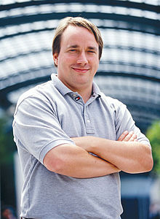
LINUS TORVALDS
Invented Linux in 1991.
Concerned with the Kernel only. (Not Utilities, or whole distributions.
Started as a hobby. Linus was a
grad student at University of
Helsinki.
Now widely adopted. (Rest is History)
No beard or moustache! (Times change!)

Slide 11
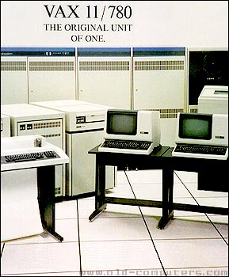
What’s the deal with Command Line?
At first teletypes is all they had.
  Printing terminals
  Better than punch cards
Then there were terminals.
And “addressable terminals”
No GUI available at first
The shell was invented by
  Stephen Bourne to talk to UNIX.

Slide 12
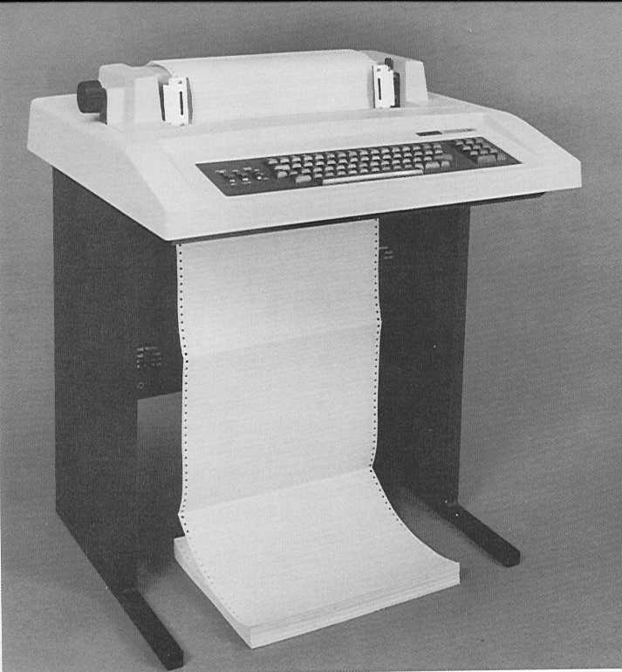
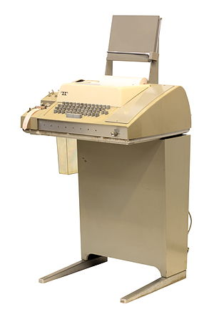
Printing Terminals
Text just scrolls up , can’t be changed.

Slide 13
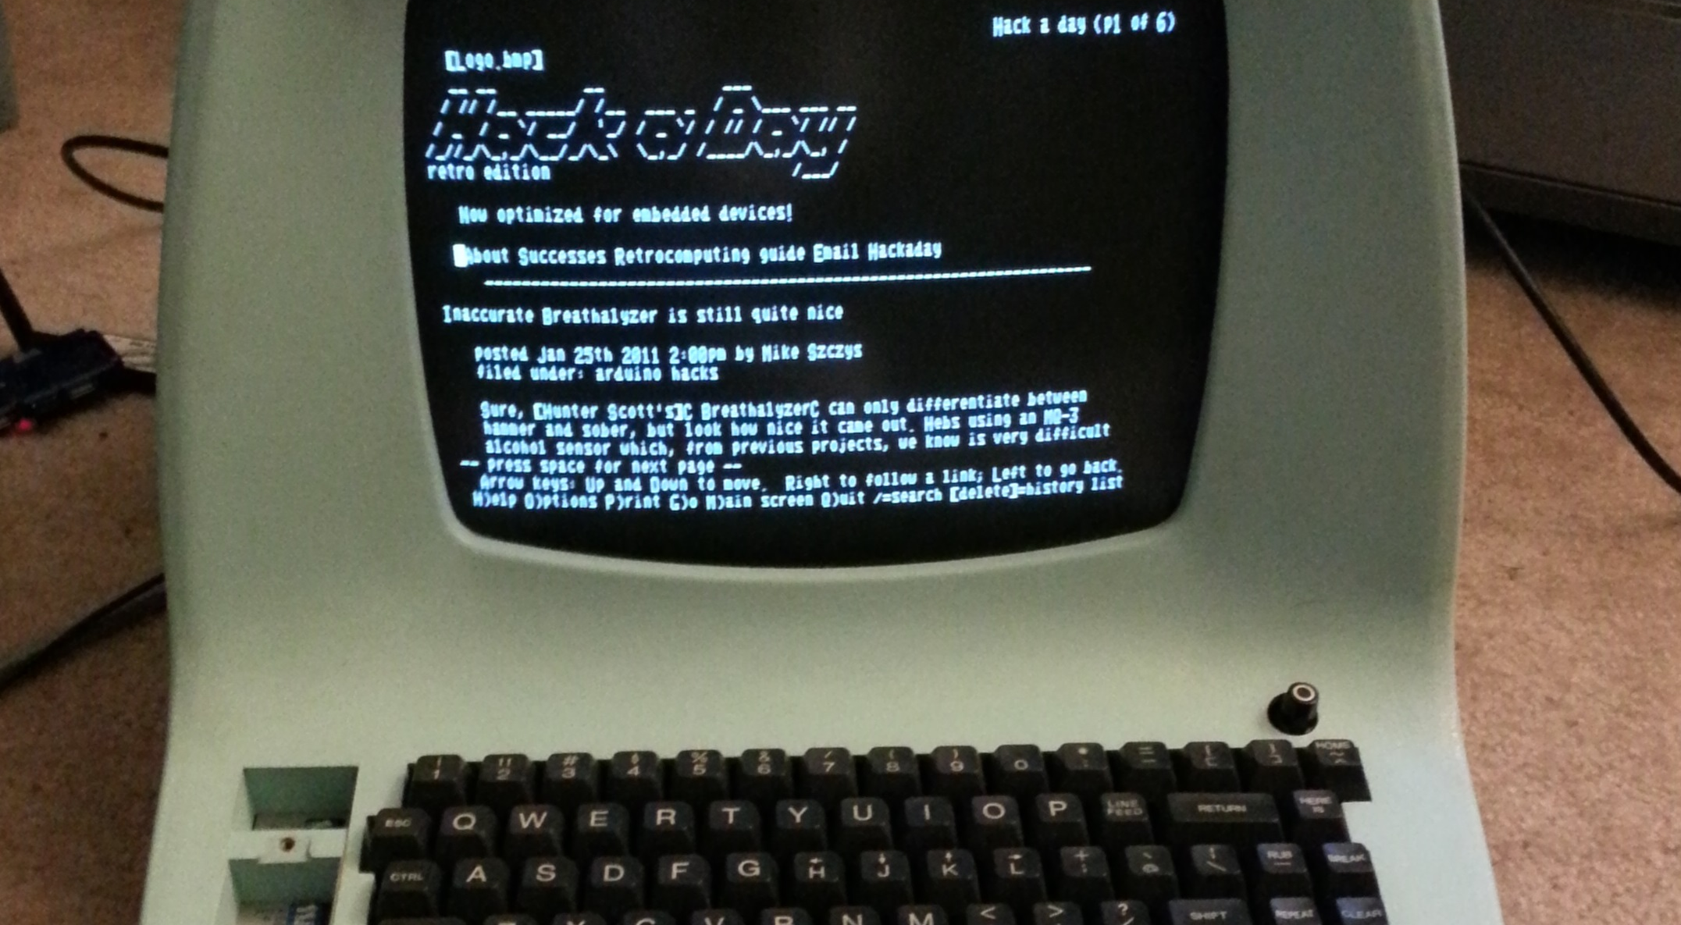
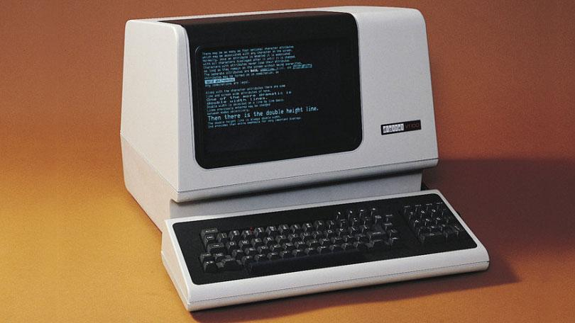
Dumb and Smart Terminals
Dumb
Smart
They look the same. What’s the deal?
So called Smart Terminal , I can move the cursor around
programmatically. Some limited graphics.

Slide 14
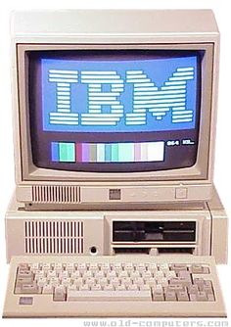
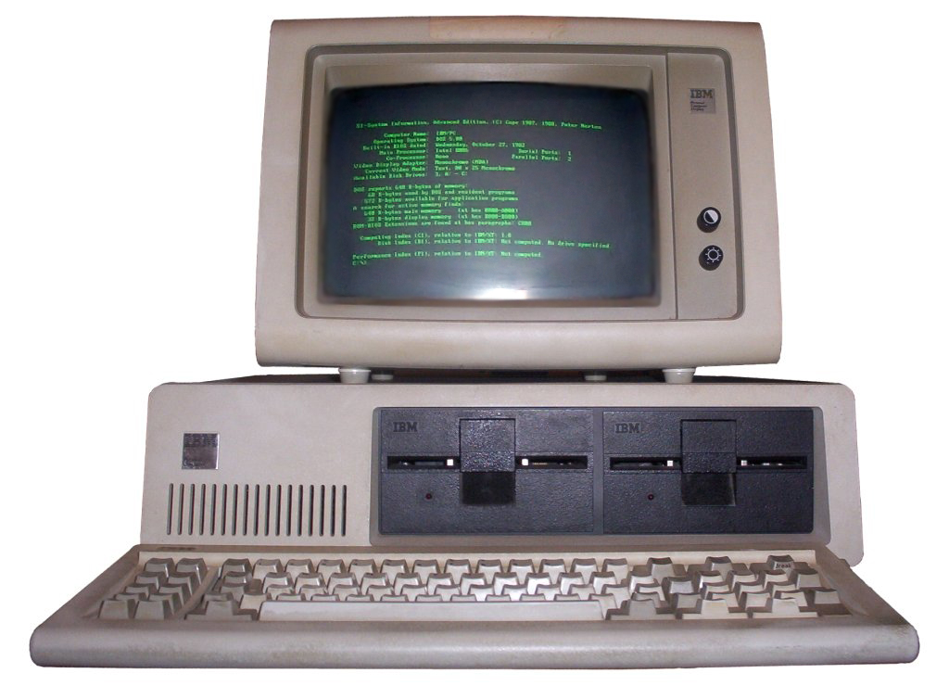
Ultimate Smart Terminals
State of the art for command line logins.
MS-DOS program called vterm , turned PC in a DEC VT220

Slide 15
Why don’t Linux people like GUIS
“We have standards, lots of them”
Despite having only approx 1% of the desktop market Linux has dozens of desktop Environments.

Slide 16
Linux can trace back its lineage to UNIX
So you can still connect terminals to a Linux “server”. However, serial port boards hard to get.
Linux runs just fine without X-Windows.
  Many Server installations do not install a GUI to conserve space and reduce attack footprint.
X Windows/display manager/GUI
Console/Apps/API
Hardware/Firmware/Kernel

Slide 17
Many GUIS
gnome 2 (MATE) (Cinnamon )
gnome 3
KDE
Unity (ubuntu only, soon to be obsolete)
Enlightenment
XFCE
LXDE
i3

Slide 18
Moral ..
So, in many cases, you are better off using command line
Remote log-ins from PCs, Macs , phones, tablets etc.
  Uses ssh protocol
  PC uses putty, securecrt
  Others use ssh

Slide 19
In Summary
Linux is a free “work-alike” alternative to UNIX. Now it is more popular than UNIX.
The command line stems from working with terminals. These terminals had limited (or no ) graphics capability, so the shell was the way to interact with the kernel.
Command line is more consistent, as there are many different GUIs in Linux.

Slide 20
Unix Philosophy
Write programs that do one thing and do it well.
Write programs to work together.
Write programs to handle text streams, because that is a universal interface
Try to treat *everything* like a file
*nix command line tends to think you know what you are doing.

Slide 21
The end

